Slide 1


Beers and Breweries
By: Aniketh Vankina, Kenneth Poling

Slide 2
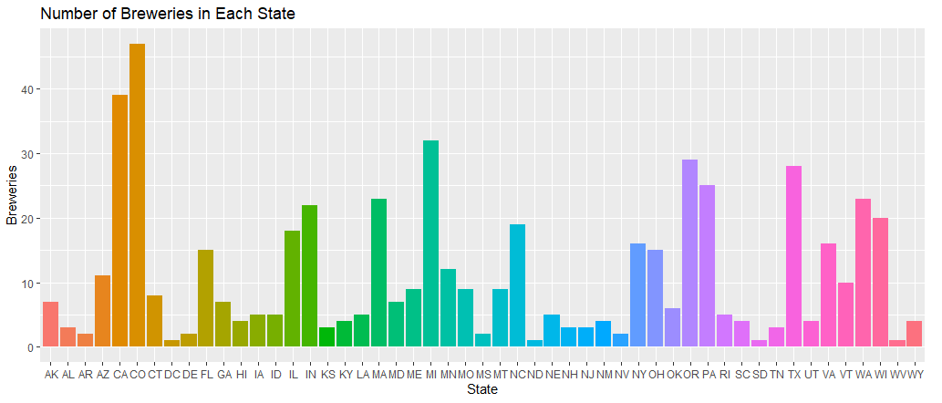
Breweries per State

Slide 3
What should we do with the missing values in Bitterness and Alcohol Content?
IBU: 1005 missing values
ABV: 62 missing values
When ABV is missing, IBU is also missing
In this case, replacing the missing values with closest distribution points is the most viable option

Slide 4
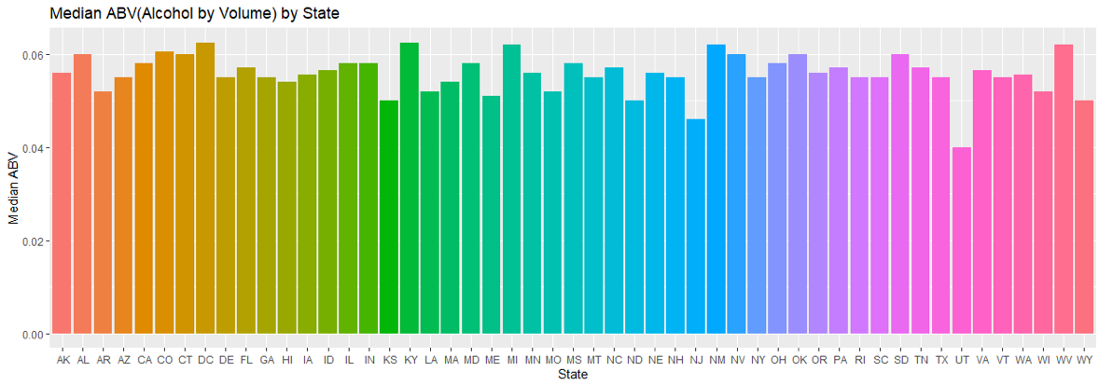
Median ABV by State
Lowest Median ABV in Utah

Slide 5
Median IBU by State
Highest IBU in Maine and West Virginia

Slide 6

Highest Alcohol Content and Bitterness
 | State | Value
Highest ABV | Colorado (CO) | 0.128
Highest IBU | Oregon (OR) | 138

Slide 7
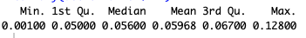
Summary Statistics
Distribution of the ABV variable slightly skewed to the right.
This is viable since higher alcohol content is reserved for liquor. Generally, ABV for a beer exceeding .20 is very rare.
As per the below table average ABV is 5.9%

Slide 8
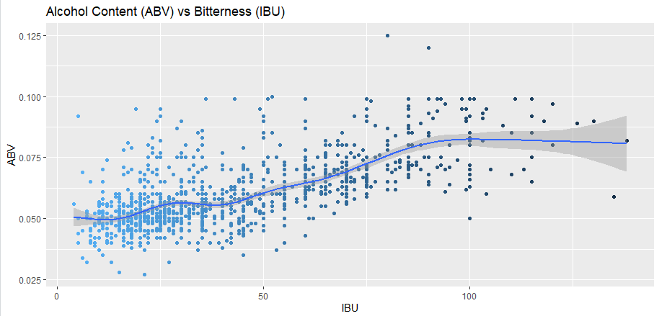
ABV vs IBU : Difference
It is hard to justify whether higher ABV percentage leads to increased bitterness.
From this data it seems that a vast majority of beers in the 5 to 10 percent range have high bitterness
It can also be the the beer type plays a big role in bitterness. (Ex: Fruit beers might have higher alcohol percentage but not as bitter).

Slide 9

Beer Type: A KNN classification
IPA tend to be have higher alcohol content as well as bitterness level (IBU) compared to Ale’s
The KNN model is not as accurate

Slide 10
Extra Data Points

